Slide 1
Image Sensing and Acquisition
This is the foundational stage where a physical scene is captured and converted into a digital format.
This process involves two essential components:
Physical sensor sensitive to electromagnetic energy.
Digitizer that converts electrical signals into digital data.
Sensing typically relies on one of three principal hardware arrangements to capture energy (such as visible light, X-rays, or infrared):
Single Sensor
Sensor Strips
Sensor Arrays

Slide 2
1)Image Acquisition using single sensors
The figure shows the three principal sensor arrangements used to transform illumination energy into digital images. The idea is simple:
Incoming energy is transformed into a voltage by the combination of input electrical power and sensor material that is responsive to the particular type of energy being detected. The output voltage waveform is the response of the sensor(s), and a
digital quantity is obtained from each sensor by digitizing its response. The most familiar sensor of this type is the photodiode.

Slide 3
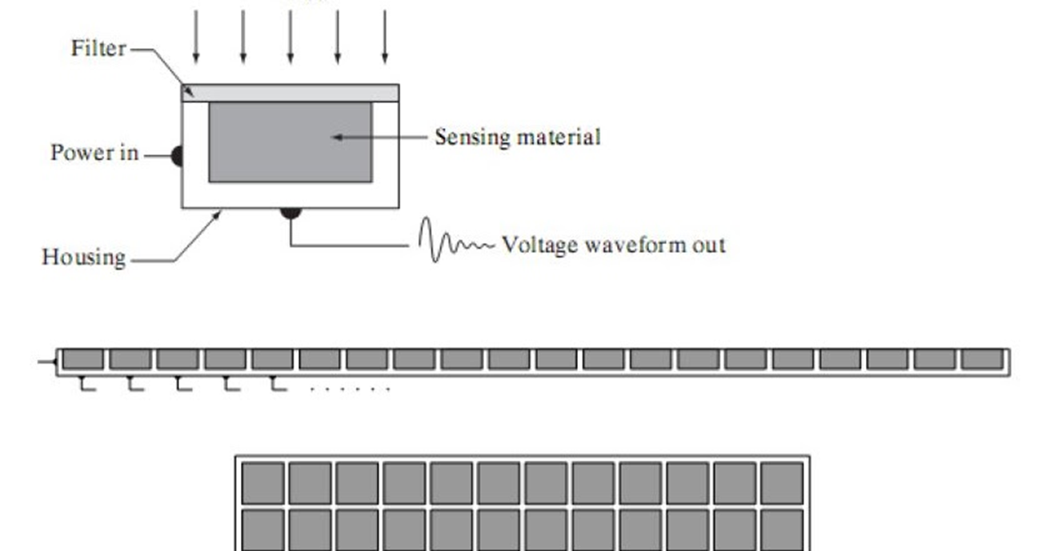

Slide 4
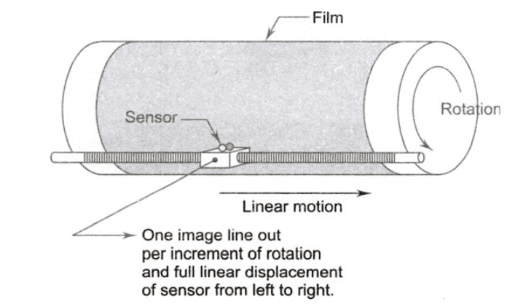

Slide 5
Using a single image sensor for 2D image processing involves moving the sensor or the object in both X and Y directions (scanning) to build the image pixel-by-pixel, often using photodiodes and filters to capture light intensity and color.
How Single Sensors Work for 2D Imaging
Light Sensing: A photodiode (a semiconductor material) converts light energy into an electrical voltage.
Filtering: A color filter (like a green pass filter) placed over the sensor allows only specific wavelengths (colors) of light to pass through, making the sensor sensitive to that color.
Scanning Mechanism:
  Mechanical Movement: The sensor is moved in one direction in the X direction (e.g., horizontally via a lead screw) while the object (like a film on a rotating drum) moves perpendicularly in the Y direction(e.g., vertically).
  Data Acquisition: As the light passes through the object and hits the sensor, the varying light intensity creates a voltage signal.
  Image Reconstruction: The sequence of voltage readings from the sensor, synchronized with the mechanical movements, is digitally assembled to form the complete 2D image.

Slide 6
Applications & Comparison
Uses: High-precision document scanners, film scanners.
Disadvantage: Slower than modern array sensors because it captures data point-by-point or line-by-line, requiring extensive mechanical movement.

Slide 7
2)Image Acquisition using a line sensor (sensor strips)
This involves arranging many sensors in a line to capture one row (or one direction either X or Y) of an image at a time, then using mechanical motion perpendicular to the strip to build the full 2D image, offering high-resolution scanning at the cost of speed, unlike single sensors that scan in X/Y or array sensors that capture all at once.
Comparison to Other Methods
Single Sensor: A single photodiode captures light, but requires precise, coordinated mechanical movement in both X and Y directions (e.g., on a rotating drum) to build a 2D image, making it slow.
Array Sensor (CCD/CMOS): A 2D grid of sensors captures the entire image at once (like a digital camera), offering speed but often lower resolution than high-end strip scanners.
Advantages of Sensor Strips
High Resolution: Can accommodate thousands of sensors for detailed images.
Cost-Effective for High Detail: Inexpensive way to get high-resolution scans because only one dimension needs precise mechanical control.
Disadvantages
Slower: Slower than array sensors because it builds the image line-by-line.

Slide 8
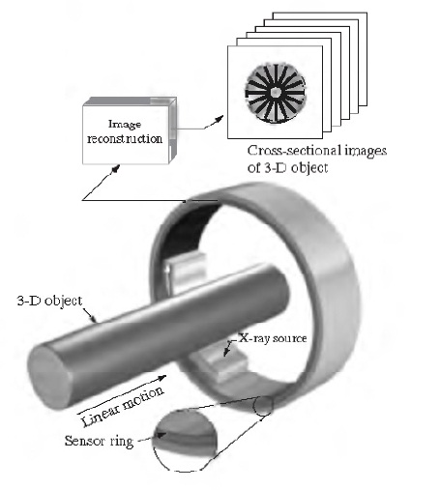

Slide 9
Array Sensor
In image processing, these sensors capture light and convert it into electrical signals, which are then digitized and processed to form a digital image.
How it Works:
Light Capture: Light from a scene reflects off objects and enters an imaging system (lens).
Projection: The lens focuses the light onto the 2D grid (array) of sensor elements.
Transduction: Each sensor element (photodiode) converts the incoming light energy into a proportional electrical charge.
Digitization: These charges are read out, converted into digital values (sampling and quantization), forming the pixels of the digital image.

Slide 10
